Slide 1
Air Passenger Count Prediction at the San Francisco Airport
By: Jamileh Jahangiry, Prachi Khanna & Se’Lina Lasher
Notes:
Jamileh

Slide 2
Introduction
Dataset (Kaggle’s SF Air Traffic Passenger and Landings Statistics):
Period: July 2005 to June 2018
Frequency: Monthly
Entries Post EDA and Feature Engineering: 156
Features: Passenger counts, activity periods, airlines, geographical summaries, regions, prices, terminals, boarding areas
Trends: Seasonality, trend (growth over time)
Goal:
Develop models to forecast monthly passenger counts at SFO
Improve resource allocation and operational efficiency
Enhance customer service and peak travel planning
Support financial planning and strategic decision-making
Stakeholders:
Airlines
Airport management
Travel agencies
Notes:
Jamileh

Slide 3
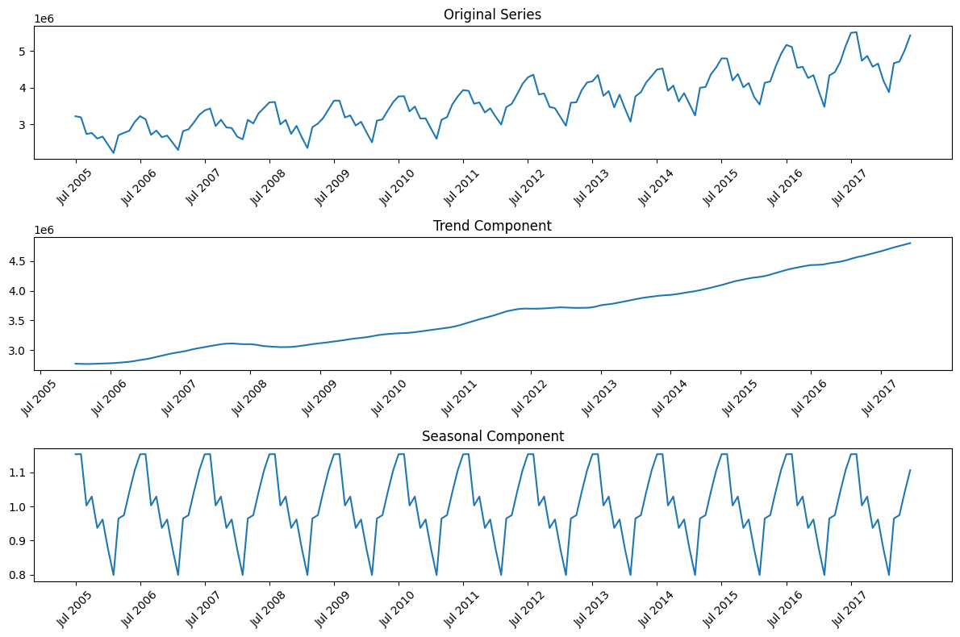
Notes:
Jamileh

Slide 4
Models and Methods
Notes:
Prachi

Slide 5
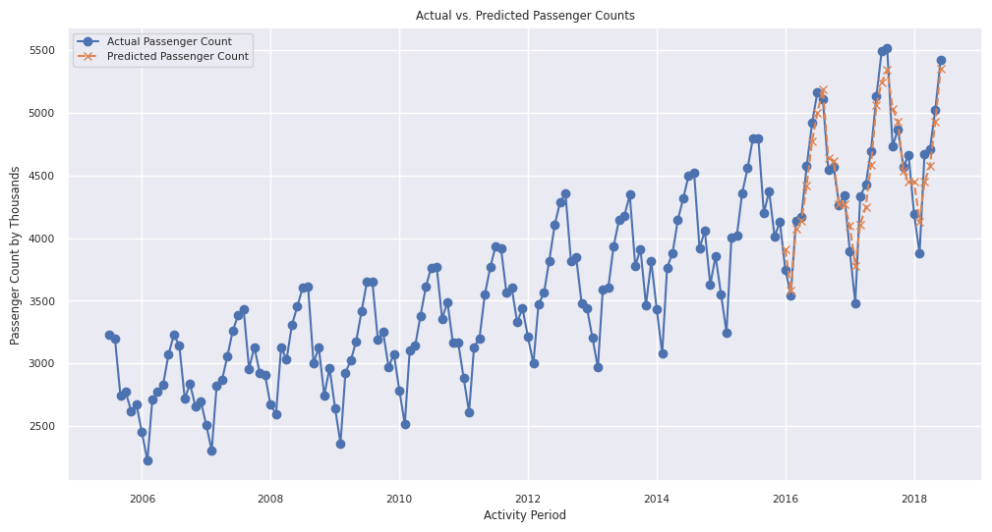
Linear Regression
Overview:
Statistical method to find the best-fit line minimizing the sum of squared differences between observed and predicted values
Uses past observations and additional features for improved accuracy
Seasonality Feature:
Added "Season" feature (Winter, Spring, Summer, Fall)
Captures seasonal patterns in air travel, such as peak travel during summer
Model Training:
Trained using passenger counts and seasonal feature from the previous six months
Including seasonality improved performance compared to the baseline model with only raw past data
Notes:
Prachi

Slide 6
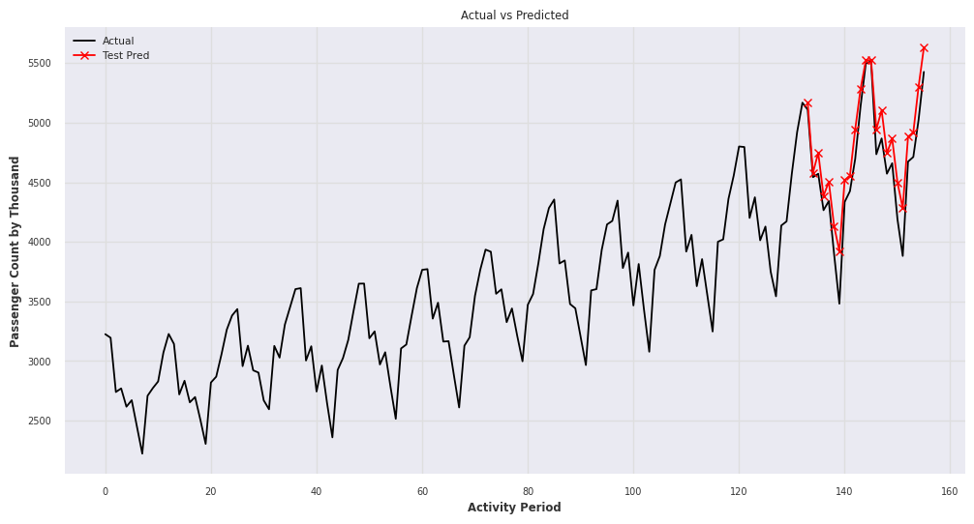
SARIMA
Overview
Extends ARIMA by incorporating seasonal effects and external variables
Used for analyzing and forecasting time series data with seasonal patterns and trends
Combines non-seasonal (p, d, q) and seasonal (P, D, Q, s) components, along with external regressors
Model Training:
Trained using passenger counts with a 12-month cycle to capture annual seasonality
Incorporates external variables to enhance forecasting accuracy
Notes:
Jamileh

Slide 7
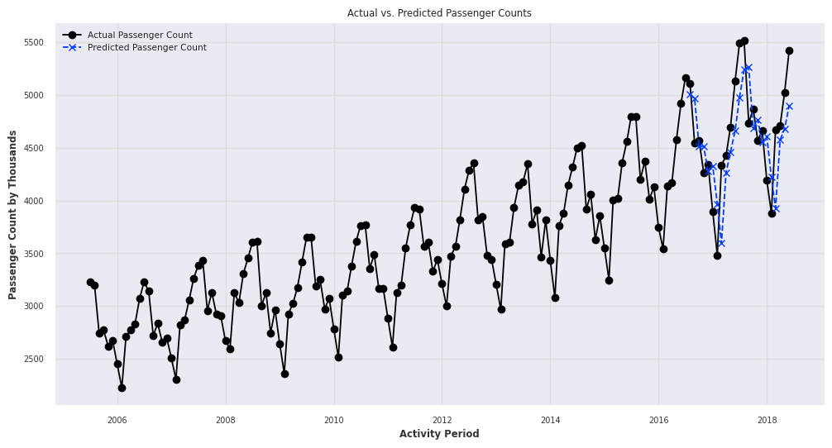
Long Short-Term Memory
Overview:
A type of recurrent neural network (RNN) designed to capture long-term dependencies and temporal relationships in sequential data
Key Features:
Capable of learning and remembering over long sequences
Effective for time series prediction due to its ability to capture temporal dependencies
Model Training:
Trained using 6 months of previous passenger counts to predict one month ahead
Optimized using Adam optimizer with a learning rate of 0.01 and early stopping
Dropped dropout layers to improve performance for the small dataset
Notes:
Se’Lina
Long Short-Term Memory, or LSTM, is a type of recurrent neural network specifically designed to capture long-term dependencies and temporal relationships in sequential data. It excels in learning and remembering patterns over long sequences, making it particularly effective for time series prediction. For our project, we trained the LSTM using six months of previous passenger counts to predict one month ahead. We optimized the model with the Adam optimizer, using a learning rate of 0.01 and early stopping to prevent overfitting. We also dropped dropout layers, aiming to improve performance given our relatively small dataset.
Despite these optimizations, the LSTM consistently underpredicted on unseen test data. We suspect this underperformance could be attributed to the limited number of data points—90 for training and 30 for validation—and the use of univariate data, focusing only on the past six months of passenger counts. These limitations may have restricted the model's ability to fully capture the underlying patterns.

Slide 8
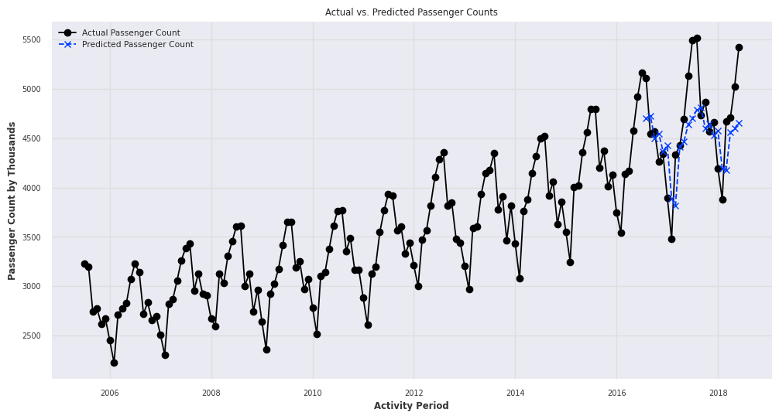
Transformer
Overview:
Originally designed for natural language processing, now applied to time series forecasting
Utilizes attention mechanisms to weigh the importance of different parts of the input data
Captures long-range dependencies more effectively than traditional RNNs
Key Insights:
Effective at capturing temporal dependencies with default parameters
Found that dropping dropout layers resulted in worse performance, unlike improvements seen with LSTM
Model Training:
Early stopping used to prevent overfitting
Trained on six-month sequences with a one-month prediction horizon
Notes:
Se’Lina
The Transformer model, originally developed for natural language processing, has found applications in time series forecasting due to its unique architecture. It utilizes attention mechanisms to assess the importance of different parts of the input data, allowing it to capture long-range dependencies more effectively than traditional RNNs. This ability makes Transformers particularly useful for time series prediction, as they can weigh past data points based on their relevance to the prediction task.
In our project, we trained the Transformer using sequences of six months of data to predict the following month. We applied early stopping to avoid overfitting, but unlike the improvements seen with the LSTM, dropping dropout layers resulted in worse performance. Our results showed that the model struggled with unseen data, often underpredicting the overall trend. Additionally, while the actual trend was increasing, our model's predictions incorrectly indicated a decreasing trend. This discrepancy highlights the challenges and complexities involved in using the Transformer model for time series forecasting, especially with our specific dataset and approach.

Slide 9
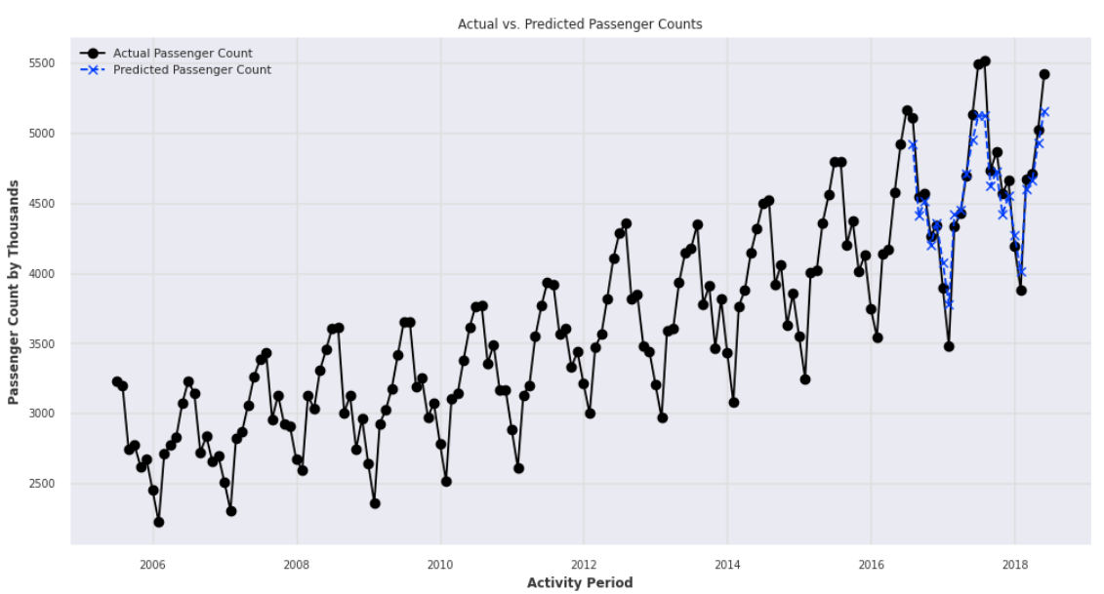
Facebook’s Prophet
Overview:
A popular pretrained model for time series forecasting
Designed to handle various types of seasonality and trends automatically
Training Approach:
Trained on the entire time series
Test data removed before training to ensure consistency with other models
Key Insights:
Performed adequately, capturing underlying patterns in the data
Notes:
Prachi

Slide 10
Results and Evaluation
Notes:
Se’Lina

Slide 11
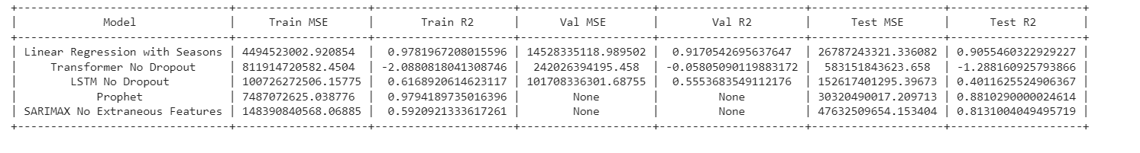
Models Performance
w/ Dropout
Highlights:
Best Performer: Linear Regression with Seasons
Achieved the lowest Test MSE and highest Test R² among all models
Demonstrated strong performance in capturing seasonal patterns, contributing to its superior accuracy
Transformer & LSTM: Showed less effective performance, especially on the Test set, with higher MSE and lower R² scores.
Prophet: Performed well in capturing underlying patterns but had the highest Test MSE compared to Linear Regression with Seasons.
Notes:
Se’Lina
In evaluating our models, we focused on the test set to understand how well they generalize to unseen data. Our best performer was the Linear Regression with seasonal adjustments, which had the lowest Test Mean Squared Error (MSE) of approximately 26.8 billion and the highest Test R² of 0.91. This model effectively captured the seasonal patterns in passenger counts.
Given that our target variable—monthly passenger counts—is in the millions, the airport would ultimately judge whether this performance meets their needs. However, the results indicate that a simpler, less computationally intensive model can be highly effective in this context.
The Transformer and LSTM models, despite their ability to handle complex temporal dependencies, showed less effective performance. The Original Transformer, with dropout layers, struggled the most, with a Test MSE of around 583.1 billion and a negative Test R². The LSTM had a Test MSE of approximately 152.6 billion and a Test R² of 0.40. These results suggest that deep learning models might not be necessary for this problem, especially given the limited data we had.
Prophet performed well, with a Test MSE of about 30.3 billion and a Test R² of 0.88, but still lagged behind Linear Regression. Lastly, SARIMAX, without extraneous features, had a Test MSE of roughly 47.6 billion and a Test R² of 0.81.
Overall, our study demonstrates that simpler models like Linear Regression with Seasons can effectively predict passenger counts, proving that deep learning isn't always required for accurate forecasting.

Slide 12
THANKS
Questions?
jjahangiry@sandiego.edu
pkhanna@sandiego.edu
slasher@sandiego.edu

